Slide 1





Introduction to React Concepts
React is a JavaScript library used for building user interfaces. React uses a declarative paradigm, making it easier to create complex user interfaces.
by Mir Junaid Rasool

Slide 2

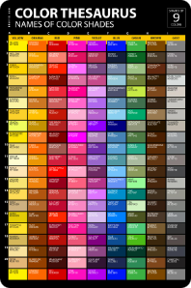
List Rendering in React
React provides methods for rendering lists of data efficiently. The `map()` method is used to iterate over an array of data and create JSX elements for each item.
1
Dynamic Lists
2
Efficiency
3
Key Usage
List rendering allows us to display dynamic content based on data.
React optimizes list rendering by efficiently updating the DOM.
Keys are essential for React to identify and update list items.

Slide 3
Forms in React
Forms are essential for collecting user input and data in web applications. React provides controlled components for managing form data and events.
Controlled Components
Event Handling
Validation
Input values are controlled by the React component state.
Event handlers update the state, triggering re-renders of the form.
Forms can be validated to ensure data integrity.

Slide 4





Conditional Rendering in React
Conditional rendering allows us to display different UI elements based on specific conditions. This is essential for building dynamic and responsive applications.
Logic
Use JavaScript expressions to determine which element to render.
Ternary Operator
A concise syntax for conditional rendering.
Logical AND Operator
Render elements based on multiple conditions.

Slide 5


Keys in React
Keys are unique identifiers assigned to each element in a list. React uses keys to efficiently track and update elements during re-renders.
Efficient Updates
Performance
Stable Elements
React uses keys to determine which elements have changed and need updating.
Keys improve performance by avoiding unnecessary DOM manipulations.
Keys ensure that elements are consistently updated in the correct order.

Slide 6

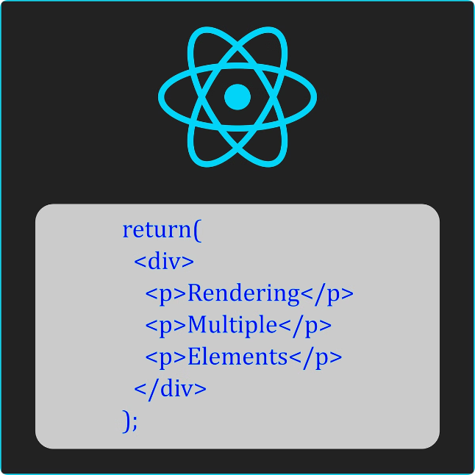
Rendering Elements in React
React elements are the building blocks of the UI. They represent virtual DOM nodes that are eventually rendered to the browser.
JSX
JavaScript XML
Syntax for defining React elements.
Components
Reusable UI building blocks.
Can be functional or class-based.
Props
Data passed to components.
Used to customize component behavior.

Slide 7


Conditional Rendering Techniques in React
Conditional rendering is a powerful technique that allows us to create dynamic and responsive user interfaces. React provides various methods for conditionally rendering elements.
Ternary Operator
1
Concise syntax for conditional rendering.
2
Logical AND Operator
Render elements based on multiple conditions.
If/Else Statements
3
Traditional conditional logic for more complex scenarios.

Slide 8





Code Examples
Here are some examples illustrating different React concepts in action.
List Rendering
Iterating through an array to display items in a list.
Form Handling
Creating a form with input fields and managing data submission.
Conditional Rendering
Displaying different elements based on conditions.

Slide 9


Conclusion and Recap
This presentation has introduced fundamental React concepts, such as list rendering, forms, conditional rendering, and keys.
1
Declarative Programming
2
Component-Based Architecture
React simplifies UI development by using a declarative approach.
Components are reusable building blocks for constructing complex UIs.
3
Virtual DOM
React optimizes DOM manipulation, resulting in efficient UI updates.

